Slide 1
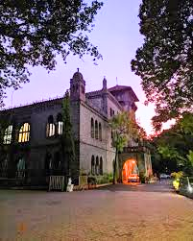
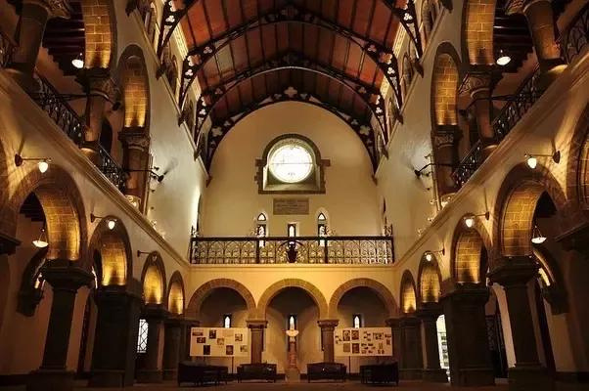

COEP Tech Hackathon
VENUE BOOKING
SYSTEM
Team Name : HackHustlers
Mukta Naik - 612203122 SY Comp
Sayali Khedkar - 612203092 SY Comp
Rutuja Dautpure - 612203032 SY Comp
Sakshi Powar - 612203145 SY Comp
Vaishnavi Shelar - 612203162 SY Comp
Isha Khutafale - 642303011 SY Comp

Slide 2
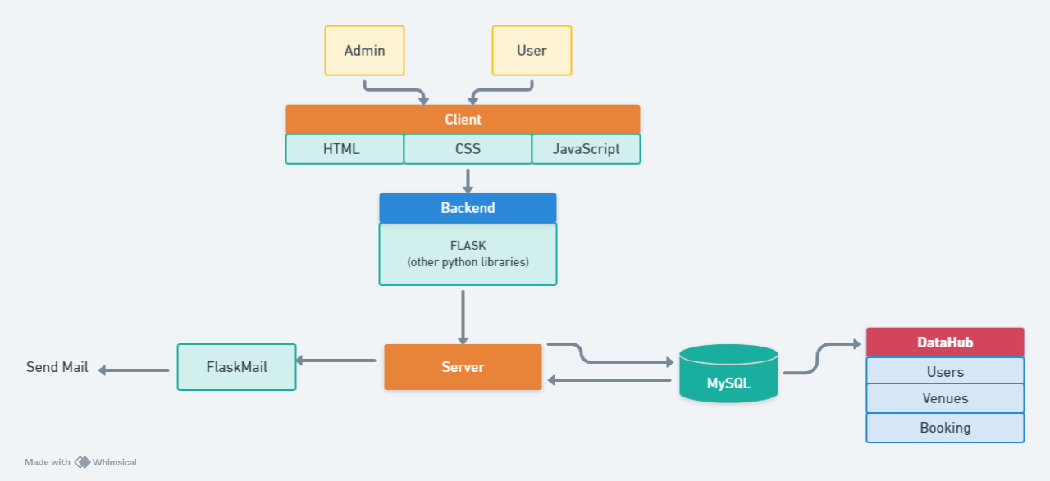

Slide 3
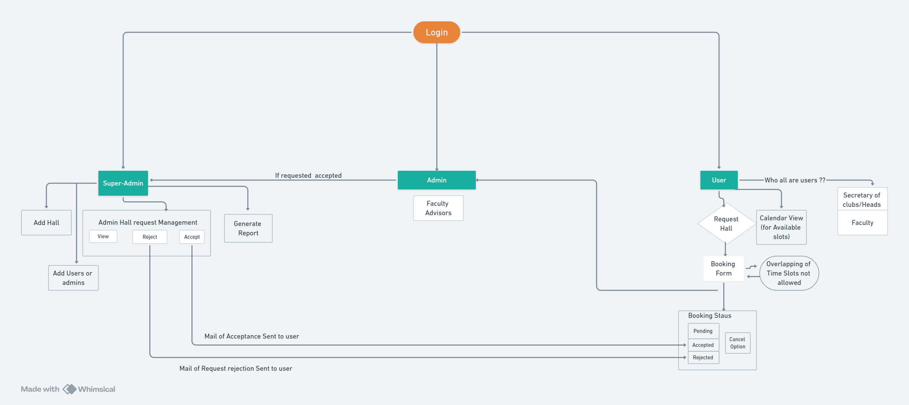

Slide 4
Features:
User Side
Booking Form
wont take reserved slots for halls
Requests Status
Cancel
Contact Admin
Login
Logout
Update Profile and Password
View Venues

Slide 5
Features:
Admin side
Login
Logout
View Venues
Accept requests from their Club secretary or head
Dynamic Calendar View

Slide 6
Features:
Super Admin Side
Login
Logout
View Venues /Add Venues
Accept / Reject / View Requests
Add Users
Add Admin(Faculty Advisors)
Analysis of Bookings
Report Generation

Slide 7
Booking Flow :
Select hall -> Select Date -> Select slot
If : hall reserved (accepted by Super-admin) for that same date , same time (or overlapping time) -> can’t book
Elif : Booking request -> put by user -> To Admin ( Faculty Advisor) -> if Accepted -> To Super -Admin -> Booking accepted -> Mail of Acceptance sent
If rejected -> mail of rejection sent

Slide 8
